Slide 1
Bank Loan Of Customers Group-3 Domain: Finance
Group Members:
Aaina Jugalkishor Lalwani
Abhinav P S
Aishwarya Tulshiram Aher
Hanuman Prakash Mode
Poonam Sanjay Nikam
Shraddha Dattatrey Shirsath
Sahil Mahesh Dalvi

Slide 2

Agenda
Introduction.
Implementation of KPIs
Challenges Faced.
Insights And Recommendations
01
06
02
05
04
03

Slide 3
Objective:
Analyzing loan data provided by a financial institution for diverse customers with varied grades and sub-grade levels, considering loan disbursement reasons, funded amount, revolving balance values, payment modes, and last payment values across different states and geolocations.
Data Points Analyzed:
Year-wise loan amount Statistics
Grade and sub-grade-wise revolving balance (revol_bal)
Total Payment for Verified Status Vs Total Payment for Non-Verified Status
State-wise and month-wise loan status
Homeownership Vs last payment date statistics
Tools Used:
Microsoft excel, SQL, Microsoft PowerBI, Tableau.

Slide 4
Loan Amount Trends The analysis of year-wise loan amounts reveals a steady increase in loan disbursements over the years, indicating a growing demand for credit among customers.

Slide 5
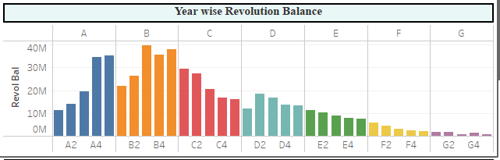
Grade and Sub Grade Analysis: Customers with higher grades and sub-grades tend to have lower average revolving balances, suggesting better credit management and lower risk of default among these segments.

Slide 6
Verified Status Impact on Payments: Verified status customers generally tend to make higher total payments compared to non-verified status customers, indicating a potential correlation between verification status and financial responsibility.

Slide 7
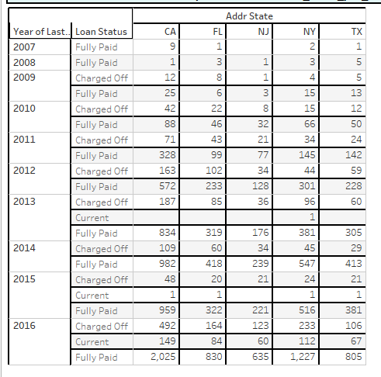
Geographical and Loan Status Trends: 1. Certain states exhibit higher rates of loan default or delinquency compared to others, indicating regional variations in credit risk. 2. Analysis of loan status over time suggests fluctuations in borrower repayment behavior, potentially influenced by economic conditions or other external factors. 3. The majority of loans are Fully Paid, followed by Charged Off and Current loan. Fully Paid loans have a significantly higher count and average count of last credit pull date compared to Charged Off and Current loans, suggesting a higher level of activity or engagement with credit reporting agencies among borrowers who have fully repaid their loans.

Slide 8
Home Ownership and Payment Behavior: 1. Customers with different types of home ownership show variations in their last payment dates, with homeownership type potentially serving as a proxy for financial stability or commitment to repay debt. 2. The statement "RENT was higher than NONE" emphasizes the significant difference in counts between RENT and NONE. This difference highlights the prevalence last payment date records associated with borrowers who have rented homes compared to those who have no home ownership status (NONE). RENT accounted for 47.54% of the total count of last payment date occurrences across all home ownership categories. This percentage indicates the proportion of last payment date records that are associated with borrowers who rent their homes. This range illustrates the diversity in the frequency of last payment date occurrences among borrowers with different home ownership statuses.

Slide 9
Challenges Faced
Duplicate values : The dataset has underlying “duplicates” which drop through “remove duplicates” option in Power Query.
Null values : Null values were present in both datasets. Checked for Null records and replaced them with correct strings or numeric values.
Manage Relationships : For making KPIs we needed data from two tables as there was common column “id” between Finance_1 & Finance_2 dataset so we used “inner join” to join both dataset.
Blank values : While importing dataset we got an error as “1292 – incorrect date value” as there were blank values present in date column. So we gave a command set sql_mode = “” ;
Importing Files in MySQL : While importing “csv” files MySQL was throwing Error – “1290 - Secure File Priv option” as the default path for importing files was uploads folder. So changed the default path as “any location”.

Slide 10
Conclusion:
The bank should continue monitoring loan disbursement trends to adjust lending practices accordingly and manage risk effectively.
Focus on verifying customer information to mitigate the risk of default, as verified status customers tend to exhibit better payment behavior.
Implement targeted strategies in regions with higher default rates to minimize credit losses and improve portfolio performance.
Tailor customer outreach and support programs based on homeownership status to encourage timely repayment and reduce delinquencies.
Further analysis could explore additional factors impacting loan performance, such as employment status, debt-to-income ratios, or credit utilization rates, to refine risk assessment models and enhance lending decisions.

